Slide 1

Cyclistic Bike-Share : Google Data Analytics Capstone Project

Slide 2
Hello ! I am Ashutosh Verma
Github : https://github.com/ashut0sh-verma
LinkedIn : linkedin.com/in/ashutosh-verma-29882a240

Slide 3
C Y C L İ S T İ C B I K E S H A R E CONTENTS
Project Purpose
The Question
Analysis Summary
Final Conclusion
Recommendation

Slide 4
Project Purpose
This project includes a data-based decision-making scenario. Driving data was analyzed in order to identify the Cyclistic company's upcoming marketing campaign and trends.

Slide 5
The Question
The director of marketing and my manager Moreno has assigned me the question to answer:
How do annual members and casual riders use Cyclistic bikes differently?

Slide 6
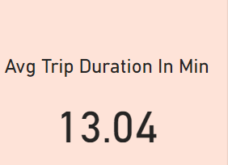
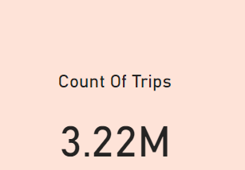
Analysis Summary

Slide 7
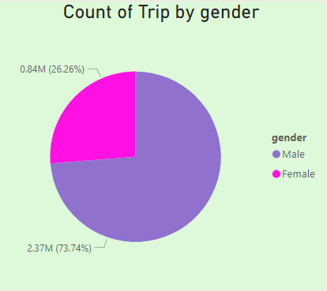
Analysis Summary
Male riders make up 73.74% of the trips (2.37M trips).
Female riders account for 26.26% of the trips (0.84M trips).

Slide 8
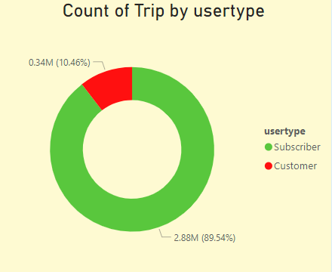
Analysis Summary
Subscribers (annual members) account for the majority of the trips, making 89.54% of the total trips.
Casual riders (Customers) make up only 10.46% of the trips.
This suggests that subscribers are the core users of the service, while casual riders are a smaller segment.

Slide 9
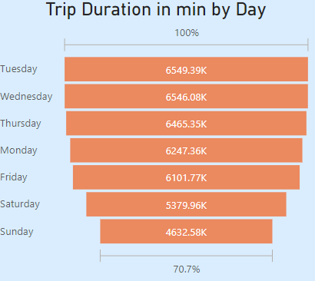
Analysis Summary
The longest trips are taken on Tuesdays (6,549.39 minutes in total), followed by Wednesdays (6,546.08 minutes).
Sunday has the shortest total trip duration with 4,632.58 minutes, indicating fewer or shorter trips on weekends.
Weekdays, in general, see higher trip durations than weekends.

Slide 10
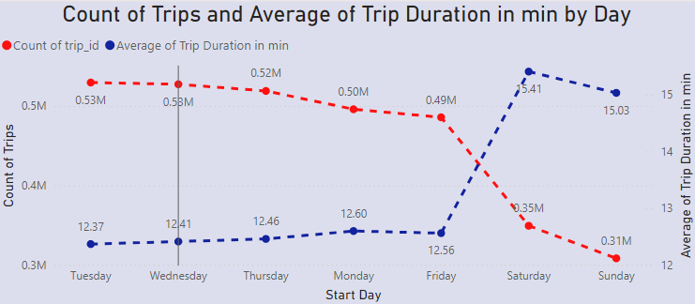
Analysis Summary
Wednesday has the highest number of trips with 0.58M trips, followed by Tuesday and Friday with around 0.53M and 0.49M trips, respectively.
Sunday has the lowest number of trips at 0.31M.
The average trip duration is longest on Saturday (15.41 minutes) and Sunday (15.03 minutes), which suggests more leisurely or recreational trips on weekends. Weekdays have shorter average trip durations, with Tuesday at 12.37 minutes and Thursday at 12.46 minutes.

Slide 11
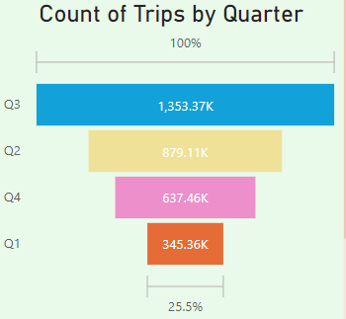
Analysis Summary
Q3 (July to September) has the highest number of trips, with 1.353 million trips, followed by Q2 (April to June) with 879.11K trips.
Q4 (October to December) and Q1 (January to March) have significantly fewer trips, with 637.46K and 345.36K trips, respectively. This indicates that cycling activity peaks during warmer months.

Slide 12
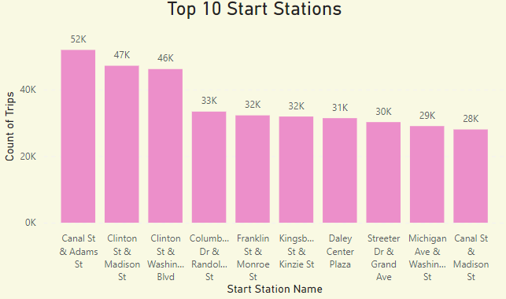
Analysis Summary
The busiest start station is Canal St & Adams St with 52K trips, followed by Clinton St & Madison St and Clinton St & Washington Blvd, with 47K and 46K trips, respectively.

Slide 13
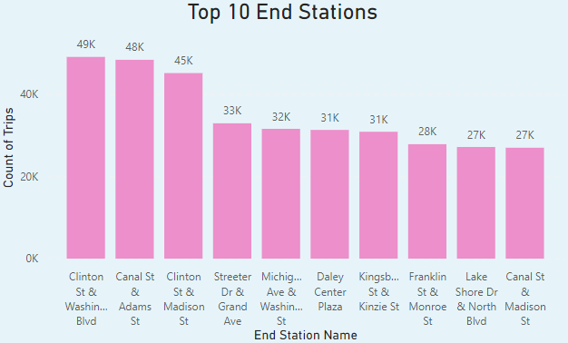
Analysis Summary
The most frequent end station is Canal St & Adams St with 49K trips, closely followed by Clinton St & Washington Blvd with 48K trips.

Slide 14
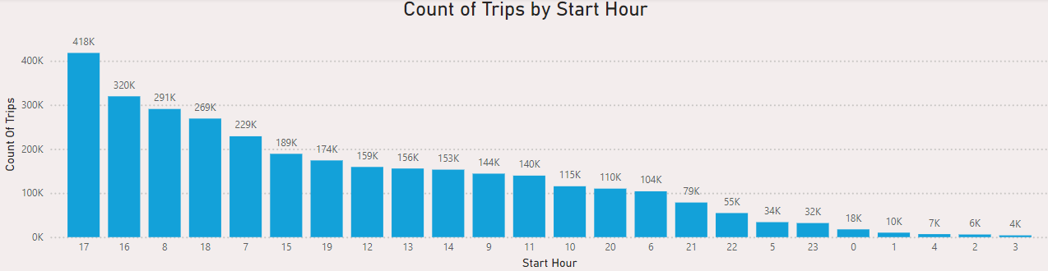
Analysis Summary
The most popular time for trips is during the 5 PM hour, with 418K trips.
The second most popular time is 4 PM, with 320K trips, followed by 8 AM with 291K trips.
There is a clear spike in usage during peak commuting hours, such as mornings (7-9 AM) and evenings (4-6 PM), indicating that many users likely use Cyclistic bikes for commuting purposes.

Slide 15
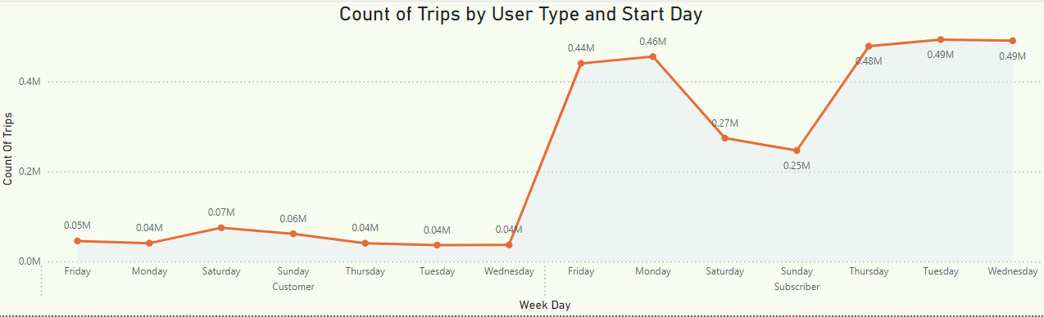
Analysis Summary
Subscribers (orange line) show a consistent number of trips across the weekdays, peaking on Friday (with 0.46M trips) and maintaining high usage on Monday, Tuesday, Wednesday, and Thursday (around 0.48M).
Casual riders (blue line), on the other hand, show a different pattern, with fewer trips on weekdays (about 0.04M) and more trips on the weekends, especially on Saturday with a slight peak at 0.07M trips.

Slide 16
Final Conclusion
From the analysis, we see that annual members ride more often during weekdays and usually take longer trips. In contrast, casual riders tend to use the bikes on weekends for shorter trips. This shows clear differences in how each group uses the bike service. Most busy station is Canal St & Adams St.The most popular time for trips is during the 5 PM hour, with 418K trips. The second most popular time is 4 PM, with 320K trips, followed by 8 AM with 291K trips. There is a clear spike in usage during peak commuting hours, such as mornings (7-9 AM) and evenings (4-6 PM), indicating that many users likely use Cyclistic bikes for commuting purposes. There is a significant drop-off in usage between 10 PM and 5 AM, which suggests that bike usage is minimal during late night and early morning hours. Subscribers show a consistent number of trips across the weekdays, peaking on Friday and maintaining high usage on Monday, Tuesday, Wednesday, and Thursday. Casual riders , on the other hand, show a different pattern, with fewer trips on weekdays and more trips on the weekends, especially on Saturday with a slight peak at 0.07M trips. This suggests that subscribers use the bikes more regularly for commuting during the week, while casual riders tend to use the bikes more for leisure on weekends.

Slide 17
Recommendation
The marketing team can work on turning casual riders into annual members by highlighting the advantages of membership. They can focus on weekends and target the stations that casual riders use the most. promoting the membership benefits during weekends or at popular casual rider locations might encourage more casual riders to convert to annual memberships. By focusing on how each group uses the service, Cyclistic can better meet their needs and improve overall satisfaction. The marketing strategy to encourage casual riders to get an annual membership should focus on key topics like saving money, improving health, helping the environment, and avoiding traffic. Highlighting the benefits of cycling in these areas can be more appealing than other transportation options.

Slide 18

Thank You

